Slide 1
Forest Park Southeast, Botanical Heights, Central West End, Medical Campus
Washington University Medical Center

Slide 2
Summary Notes: FPSE August 2019
## [1] "20 total crimes in August 2019"
## [1] "11.1% change compared to August 2018 (18 total crimes)"
## [1] "1 crime(s) against persons in August 2019"
## [1] "-75.0% change compared to August 2018 (4 crimes against persons)"
## [1] "166 total crimes in 2019"
## [1] "25.8% change compared to this time in 2018 (132 total crimes)"
## [1] "27 crime(s) against persons in 2019"
## [1] "-20.6% change compared to this time in 2018 (34 crimes against persons)"

Slide 3
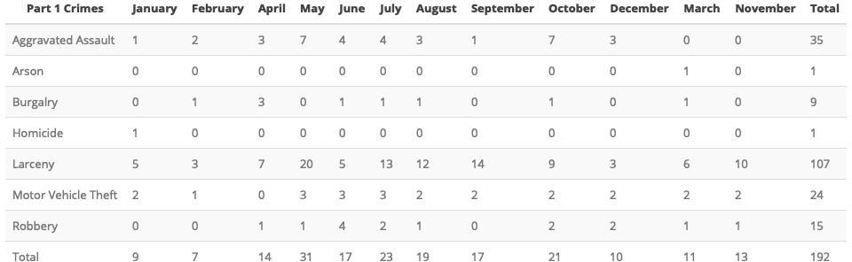
Comparing 2018 to 2019: Forest Park Southeast

Slide 4
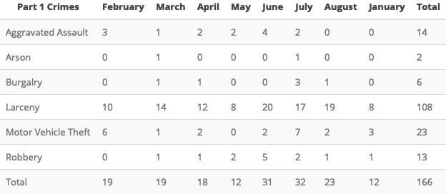

Slide 5
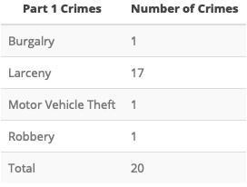
Forest Park Southeast: August 2019

Slide 6
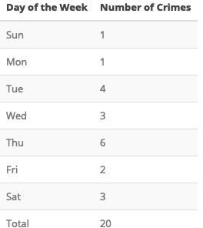

Slide 7
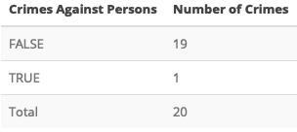

Slide 8
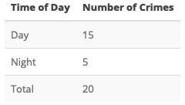

Slide 9
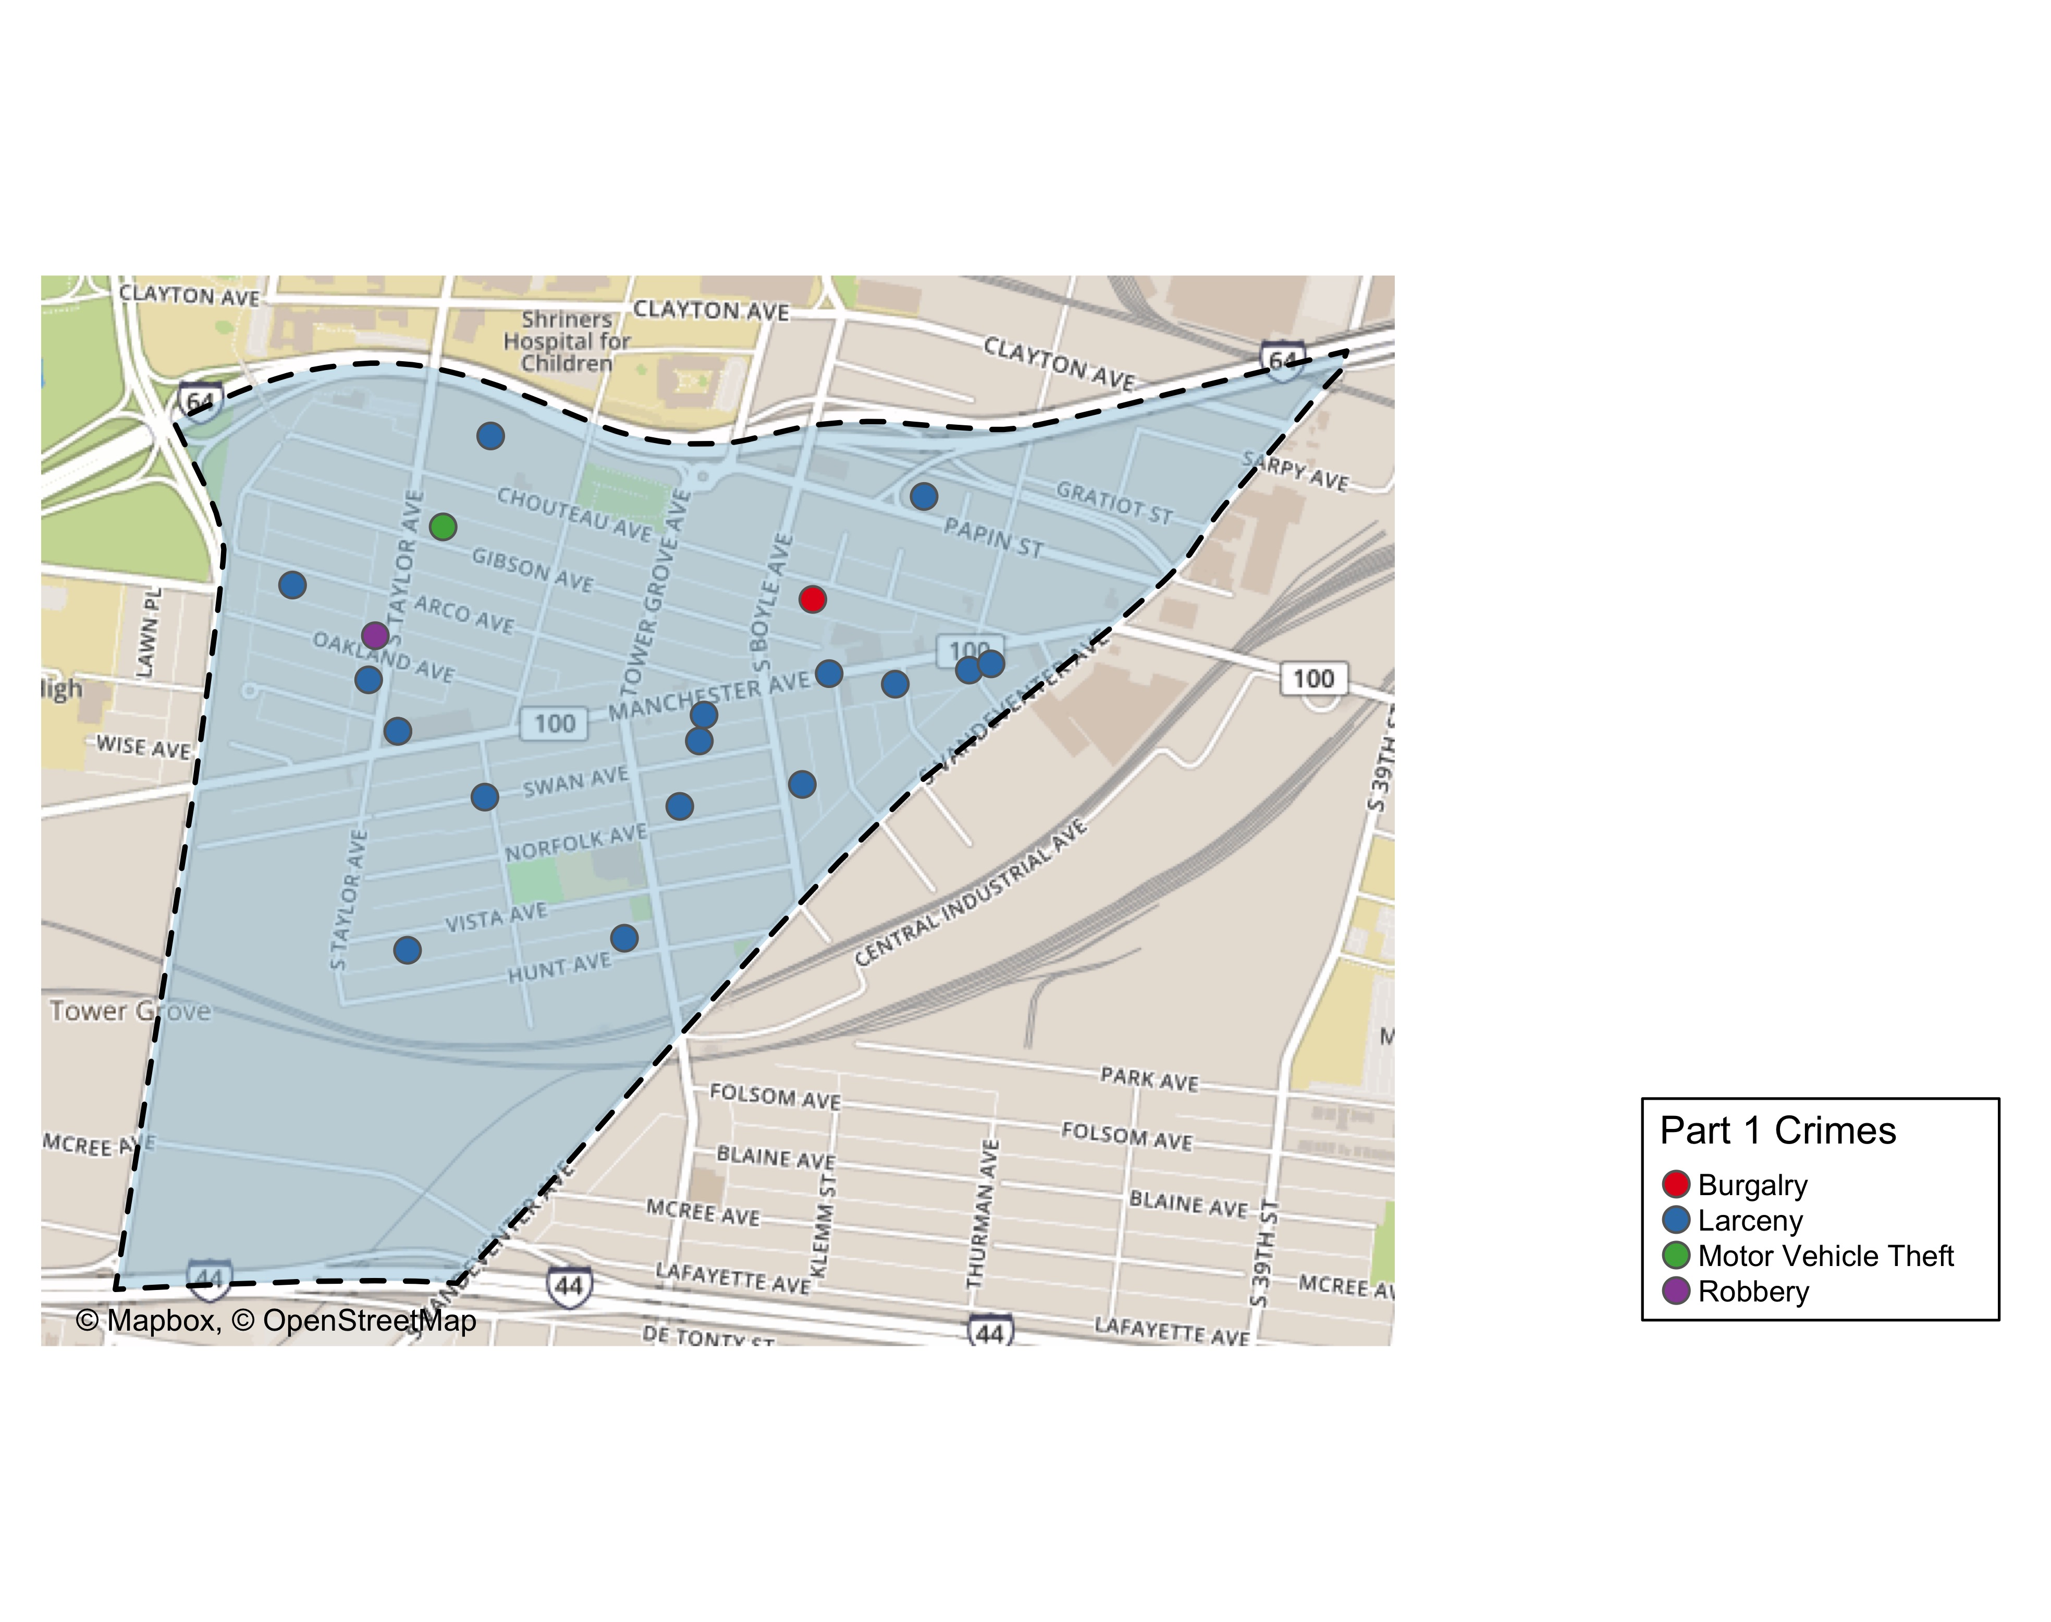
Forest Park Southeast Total Crime

Slide 10
Summary Notes: Botanical Heights
## [1] "4 total crimes in August 2019"
## [1] "-77.8% change compared to August 2018 (18 total crimes)"
## [1] "1 crime(s) against persons in August 2019"
## [1] "0% change compared to August 2018 (1 crimes against persons)"
## [1] "53 total crimes in 2019"
## [1] "-32.1% change compared to this time in 2018 (78 total crimes)"
## [1] "9 crime(s) against persons in 2019"
## [1] "28.6% change compared to this time in 2018 (7 crimes against persons)"

Slide 11
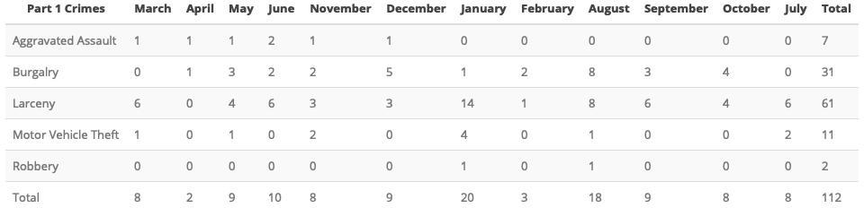
Comparing 2018 to 2019: Botanical Heights

Slide 12
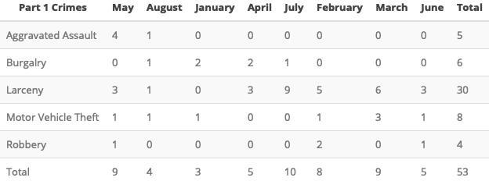

Slide 13
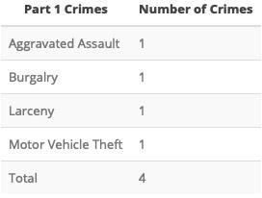

Slide 14
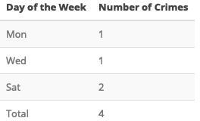

Slide 15
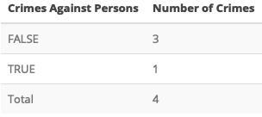

Slide 16
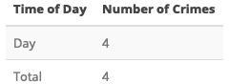

Slide 17
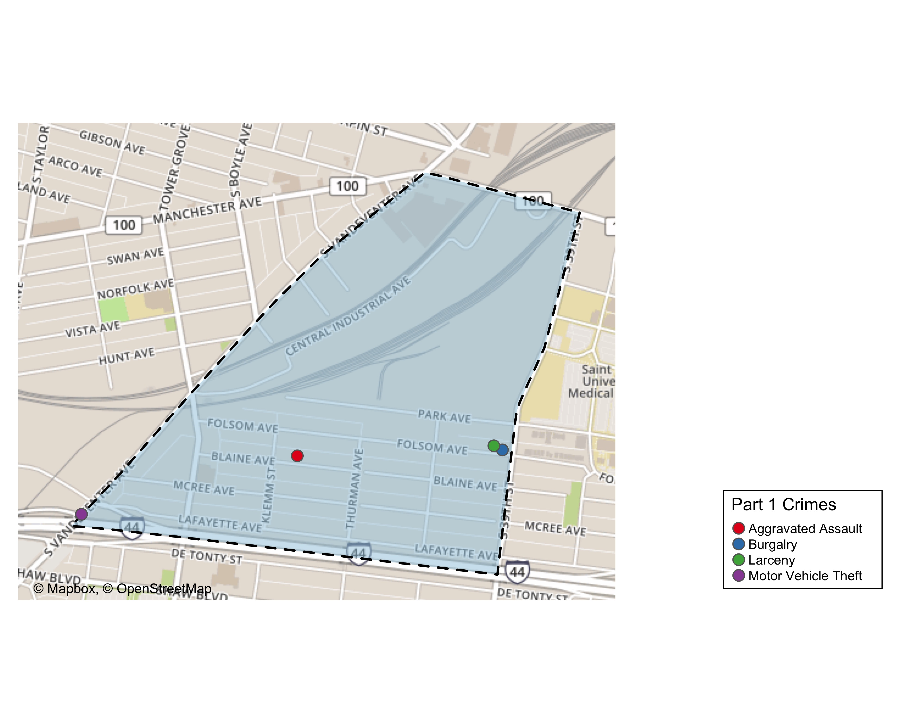
Botanical Heights Total Crime

Slide 18
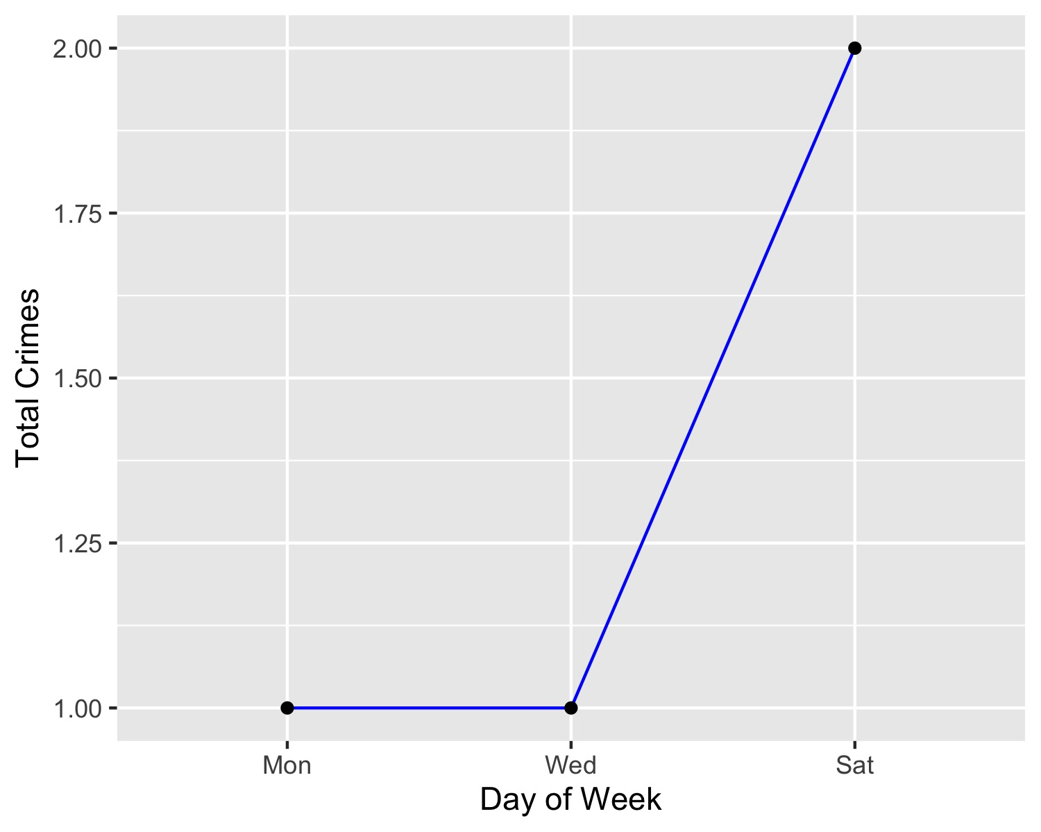
Botanical Heights Crime by Days of the Week

Slide 19
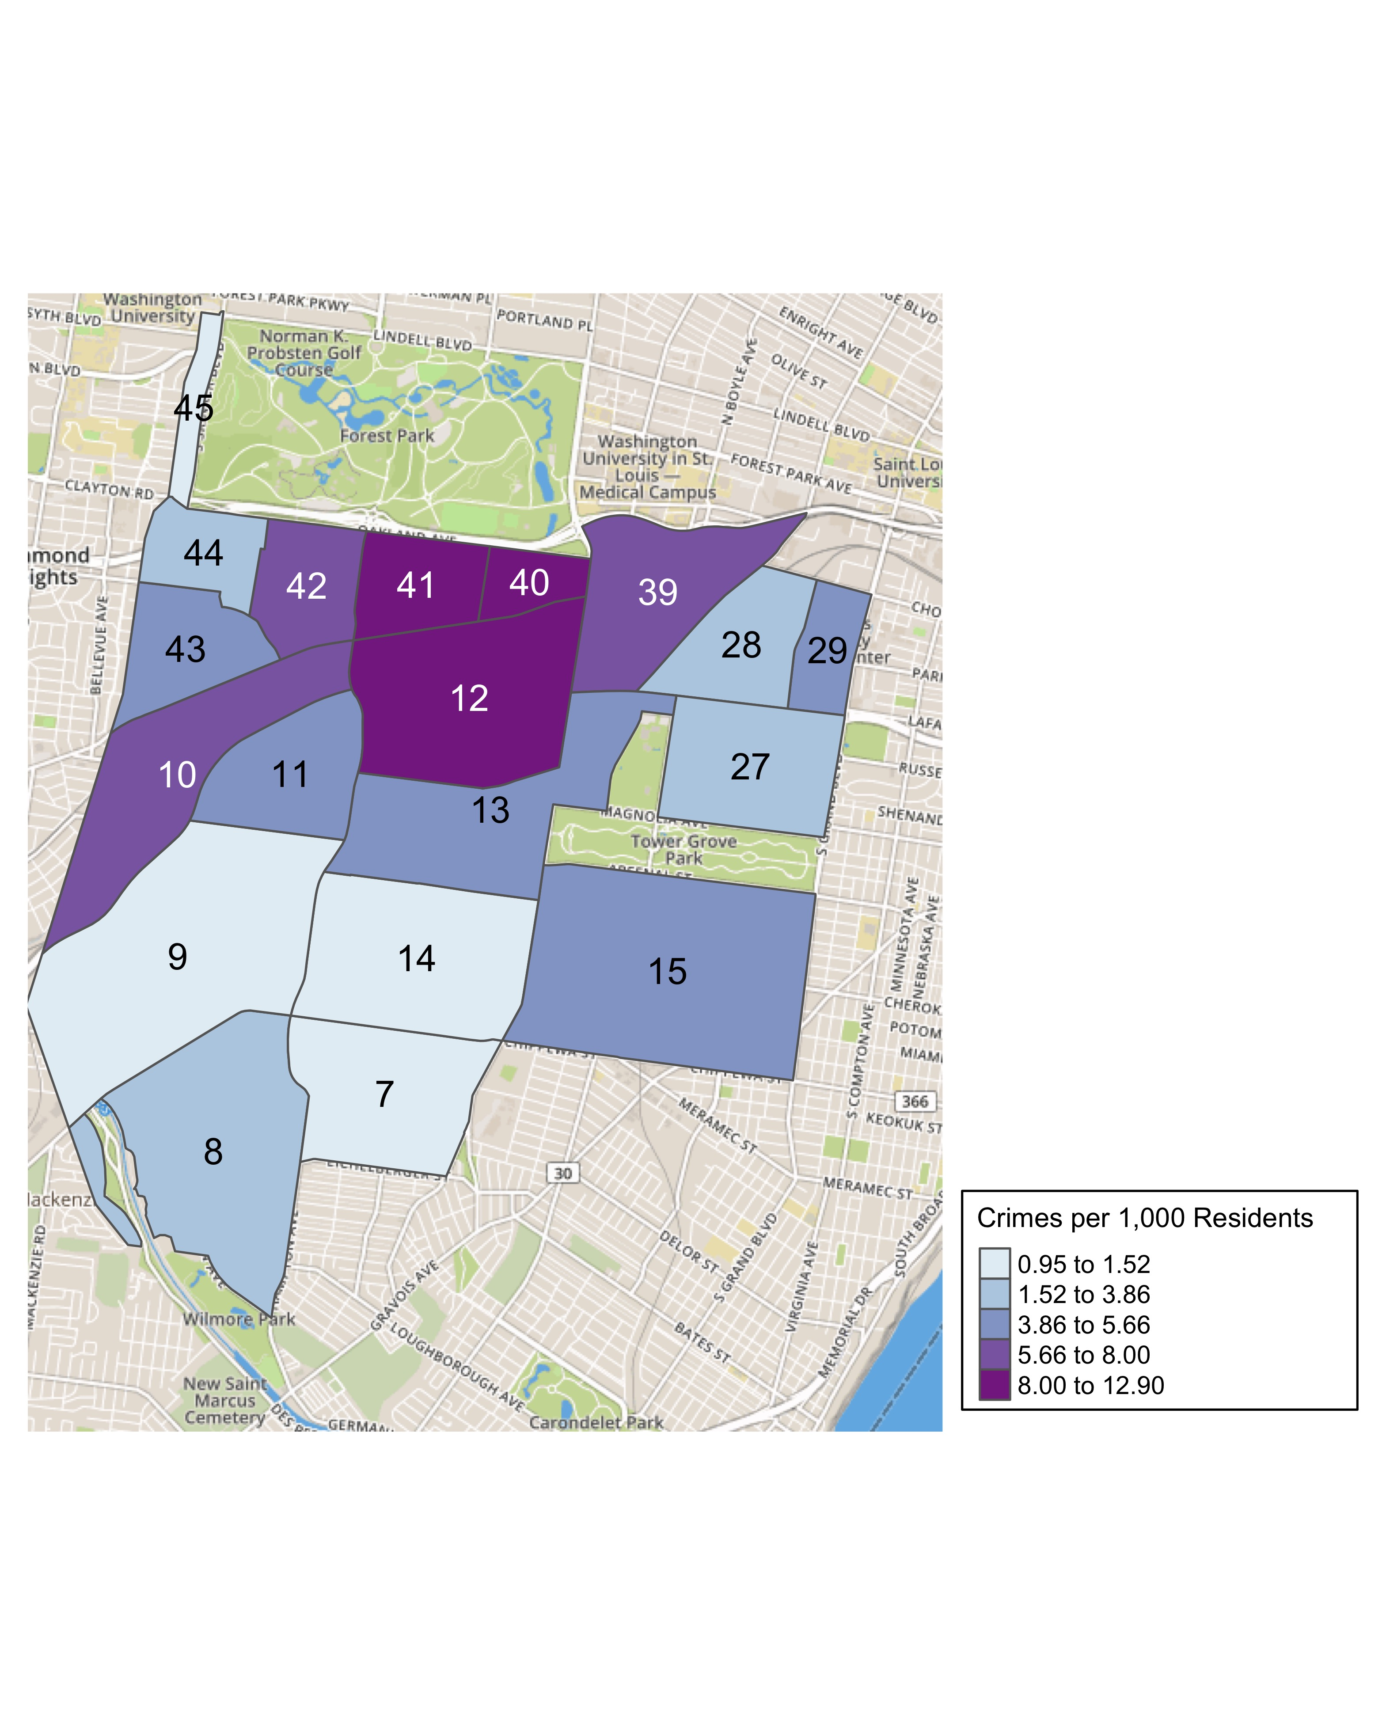
District 2 Crime Rates

Slide 20
District 2 Density Map Explanation
There are 23 neighborhoods in District 2. The South Hampton neighborhood is split between District 2 and District 1.
## [1] "The minimum number of crimes in one neighborhood was 1 (Wydown Skinker)"
## [1] "The maximum number of crimes in one neighborhood was 72 (Tower Grove South)"
## [1] "The mean number of crimes in one neighborhood was 15.95"
## [1] "The minimum rate of crimes in one neighborhood was 0.95 (Wydown Skinker)"
## [1] "The maximum rate of crimes in one neighborhood was 12.9 (Cheltenham)"
## [1] "The mean rate of crimes in one neighborhood was 5.28"

Slide 21
Summary Notes: Central West End
## [1] "121 total crimes in August 2019"
## [1] "0% change compared to August 2018 (121 total crimes)"
## [1] "18 crime(s) against persons in August 2019"
## [1] "38.5% change compared to August 2018 (13 crimes against persons)"
## [1] "770 total crimes in 2019"
## [1] "-8.33% change compared to this time in 2018 (840 total crimes)"
## [1] "101 crime(s) against persons in 2019"
## [1] "17.4% change compared to this time in 2018 (86 crimes against persons)"

Slide 22
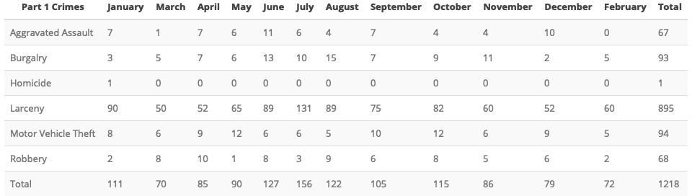
Comparing 2018 to 2019: Central West End

Slide 23
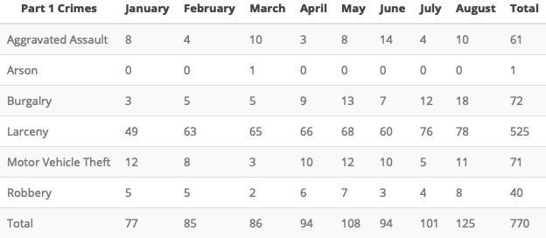

Slide 24
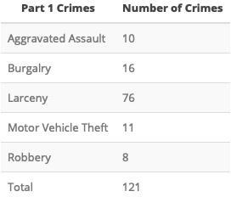
Central West End: August 2019

Slide 25


Slide 26
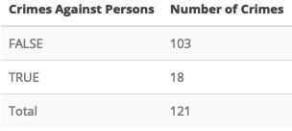

Slide 27
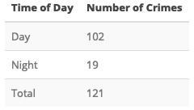

Slide 28
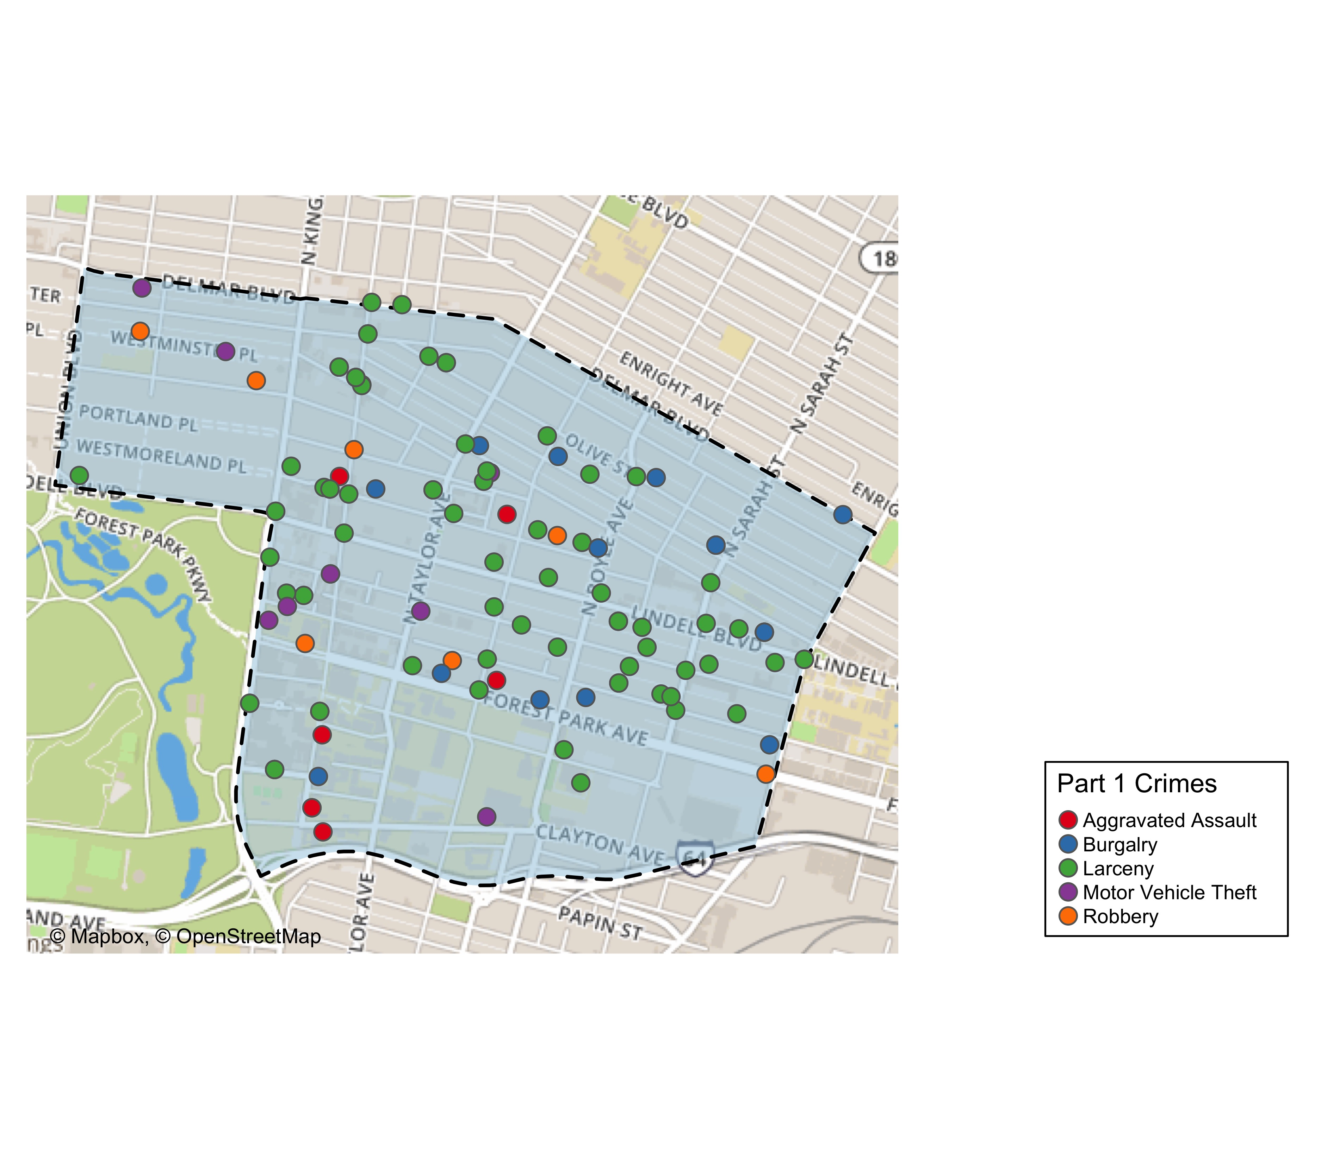
Central West End Total Crime

Slide 29
Washington University Medical Campus: August 2019
## [1] "12 total crimes in August 2019"
## [1] "200% change compared to August 2018 (4 total crimes)"
## [1] "6 crime(s) against persons in August 2019"
## [1] "Inf change compared to August 2018 (0 crimes against persons)"
## [1] "84 total crimes in 2019"
## [1] "25.4% change compared to this time in 2018 (67 total crimes)"
## [1] "16 crime(s) against persons in 2019"
## [1] "129% change compared to this time in 2018 (7 crimes against persons)"

Slide 30
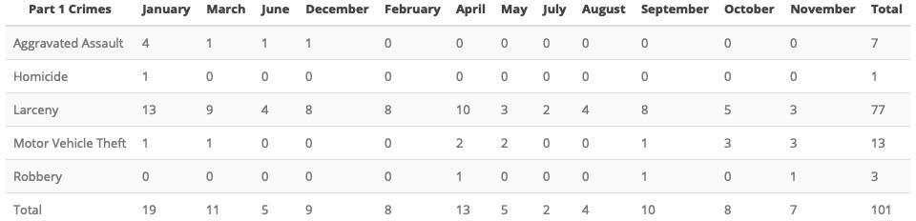
WUMC Campus: Comparing 2018 and 2019

Slide 31
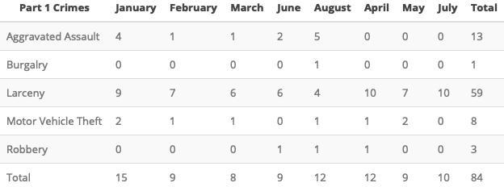

Slide 32
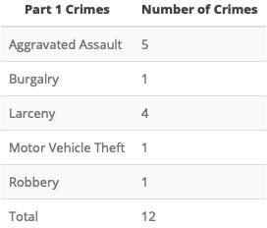
WUMC Campus: August 2019

Slide 33
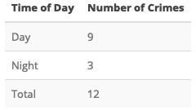

Slide 34
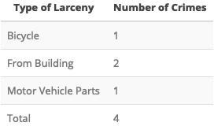

Slide 35
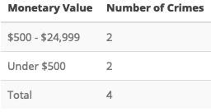

Slide 36
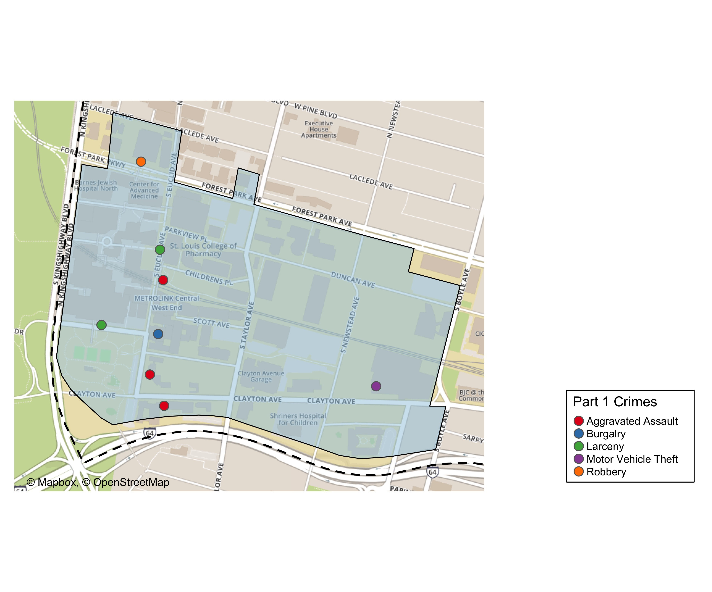
Med. Campus Total Crime: August 2019

Slide 37
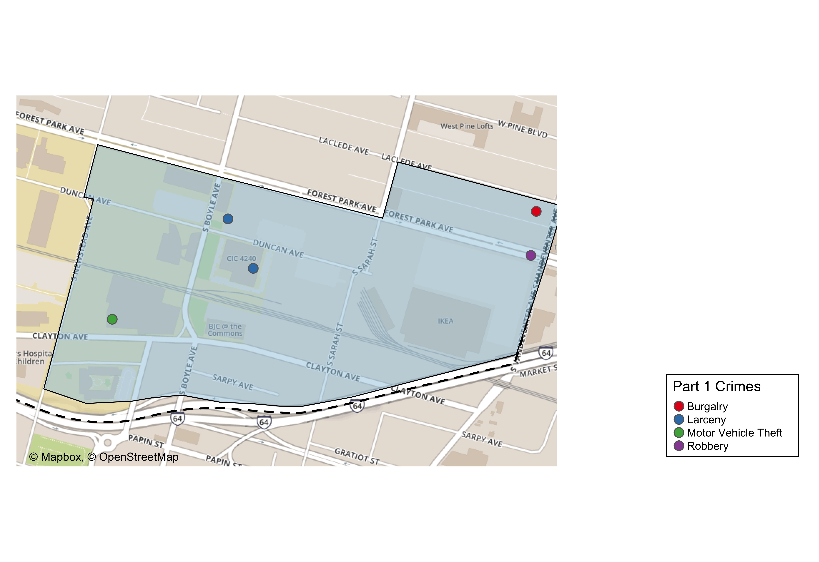
Cortex Total Crimes

Slide 38
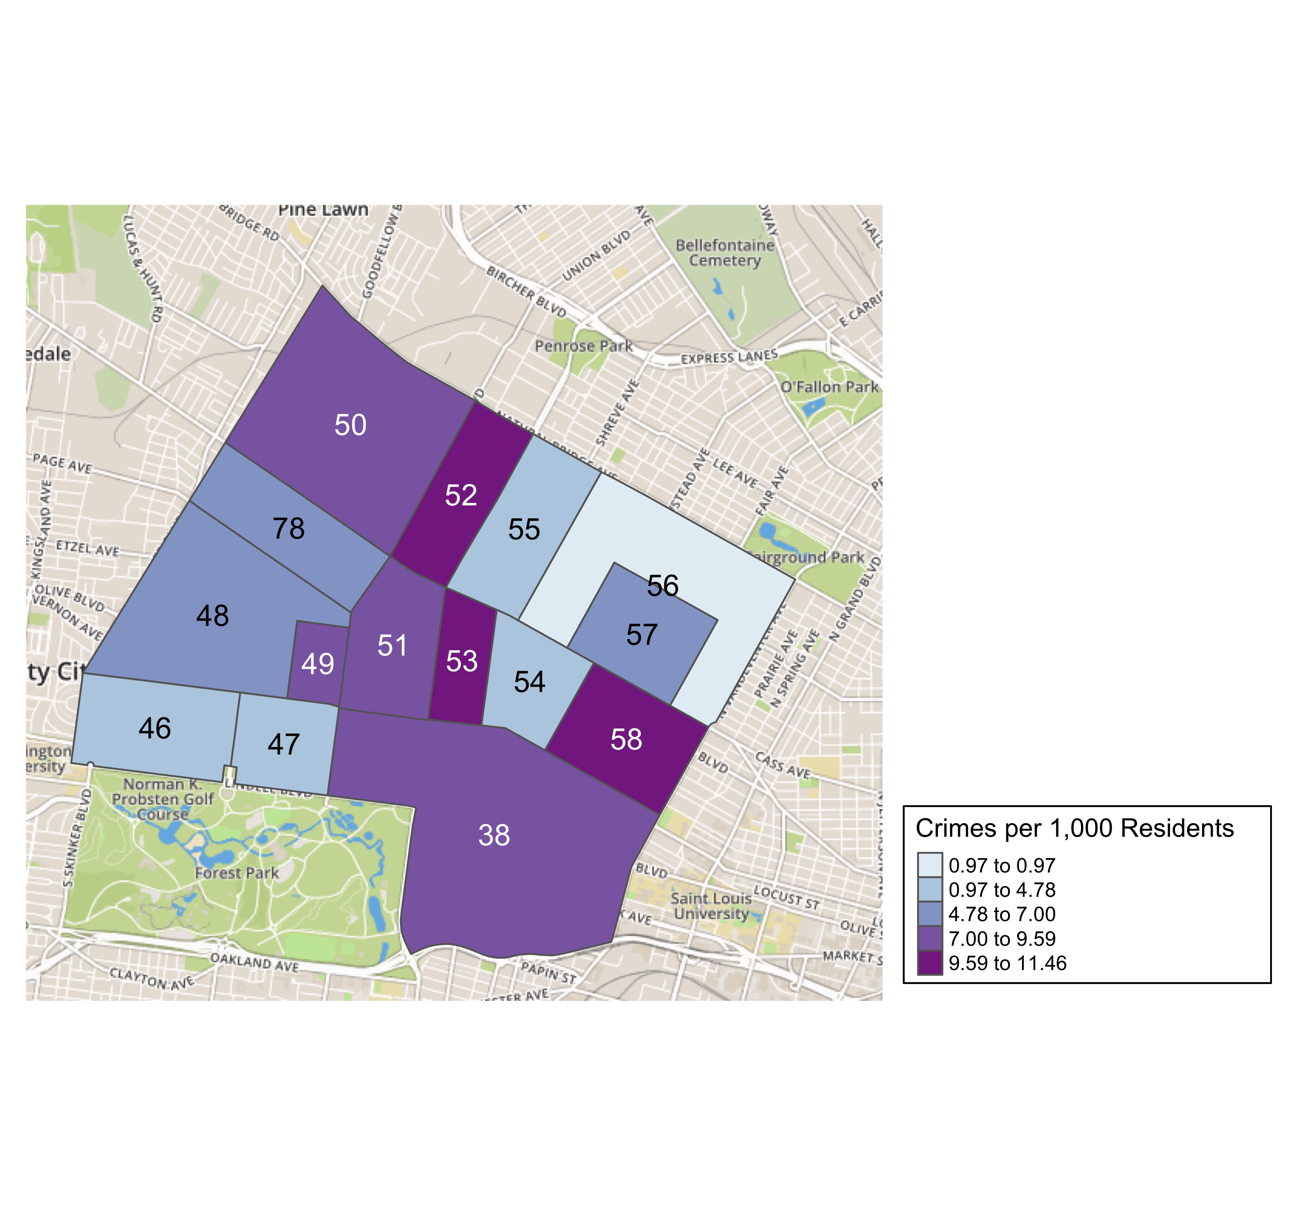
District 5 Crime Rates

Slide 39
District 5 Density Map Explanation
There are 15 neighborhoods in District 5.
## [1] "The minimum number of crimes in one neighborhood was 6 (Greater Ville)"
## [1] "The maximum number of crimes in one neighborhood was 121 (Central West End)"
## [1] "The mean number of crimes in one neighborhood was 27.27"
## [1] "The minimum rate of crimes in one neighborhood was 0.97 (Greater Ville)"
## [1] "The maximum rate of crimes in one neighborhood was 11.46 (Fountain Park)"
## [1] "The mean rate of crimes in one neighborhood was 7.02"

Slide 40
Forest Park Southeast Neighborhood Detail
Appendix 1

Slide 41
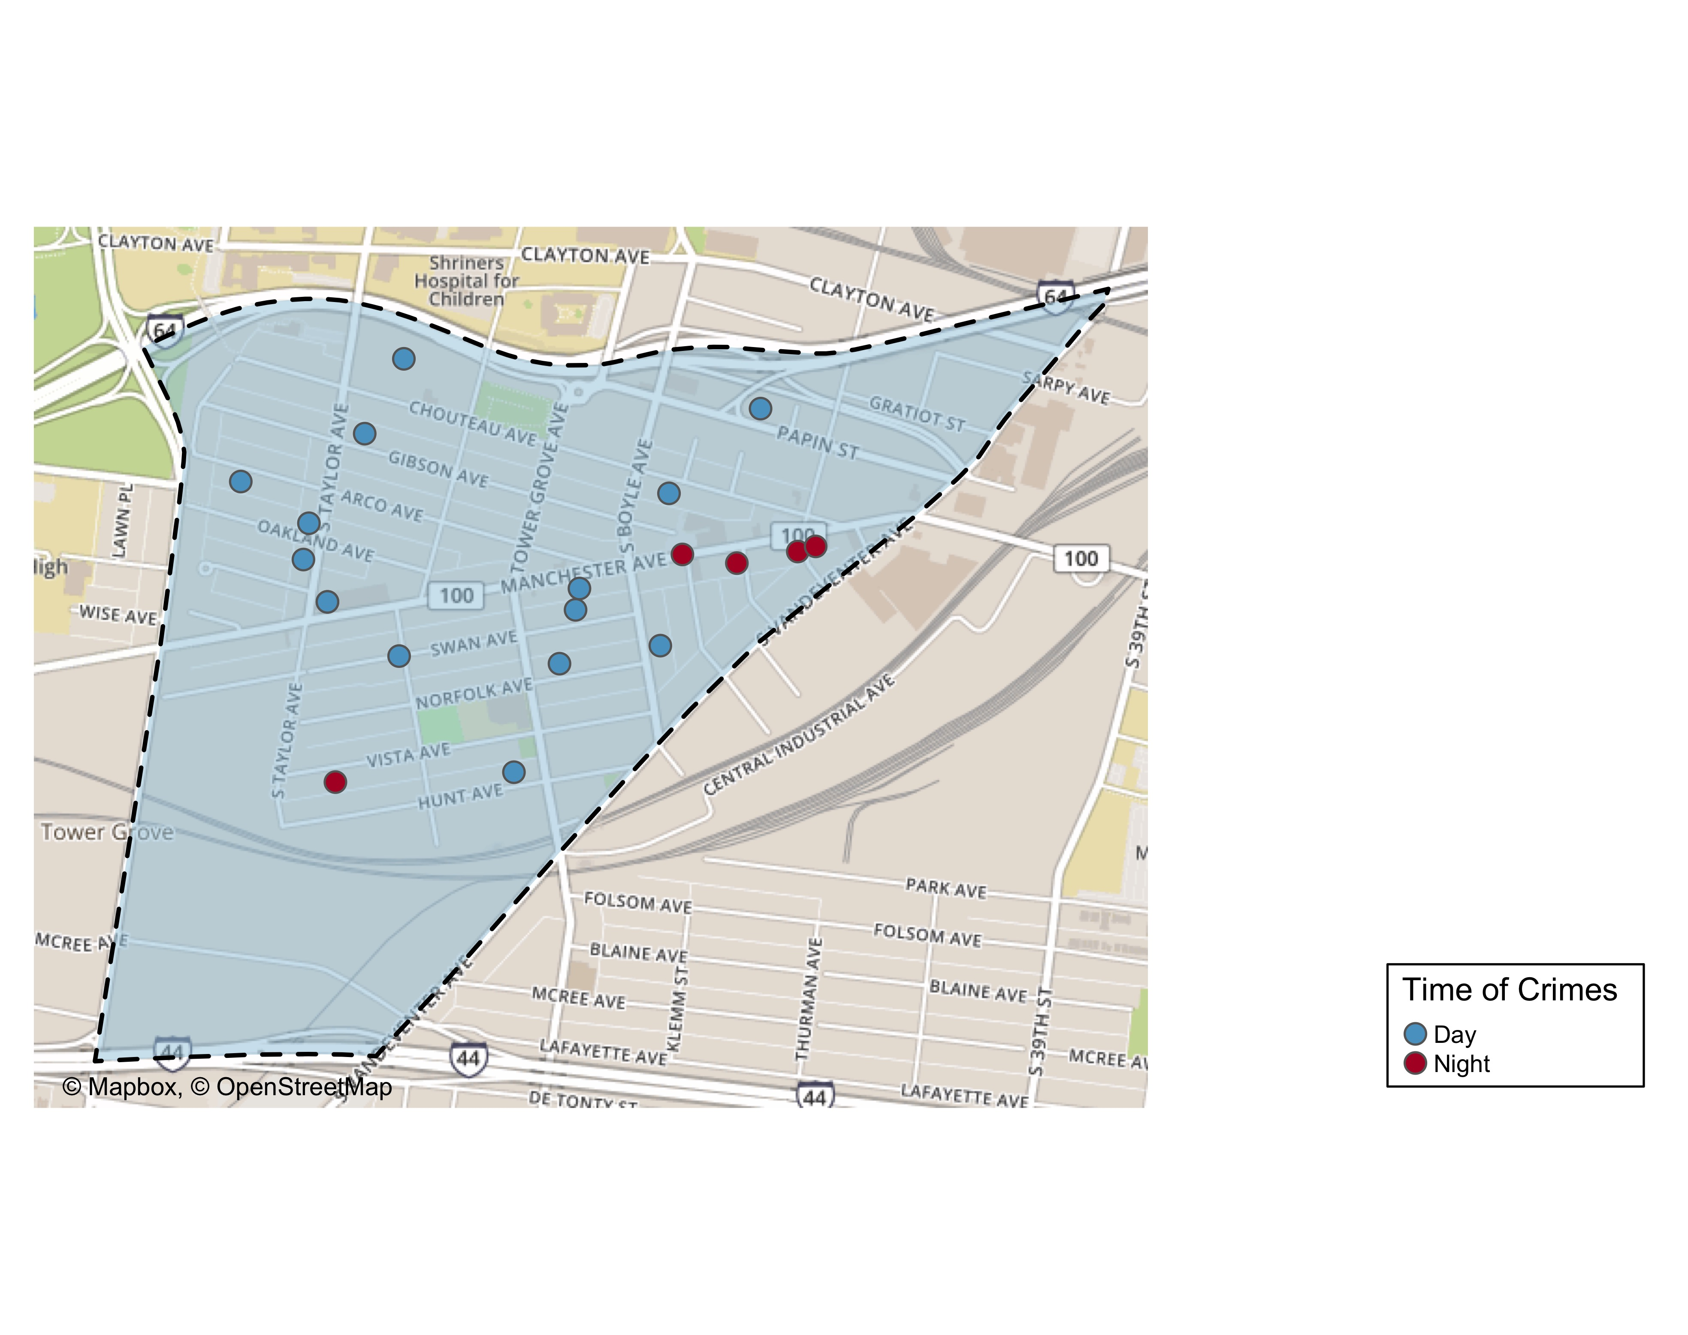
FPSE Time of Crimes

Slide 42
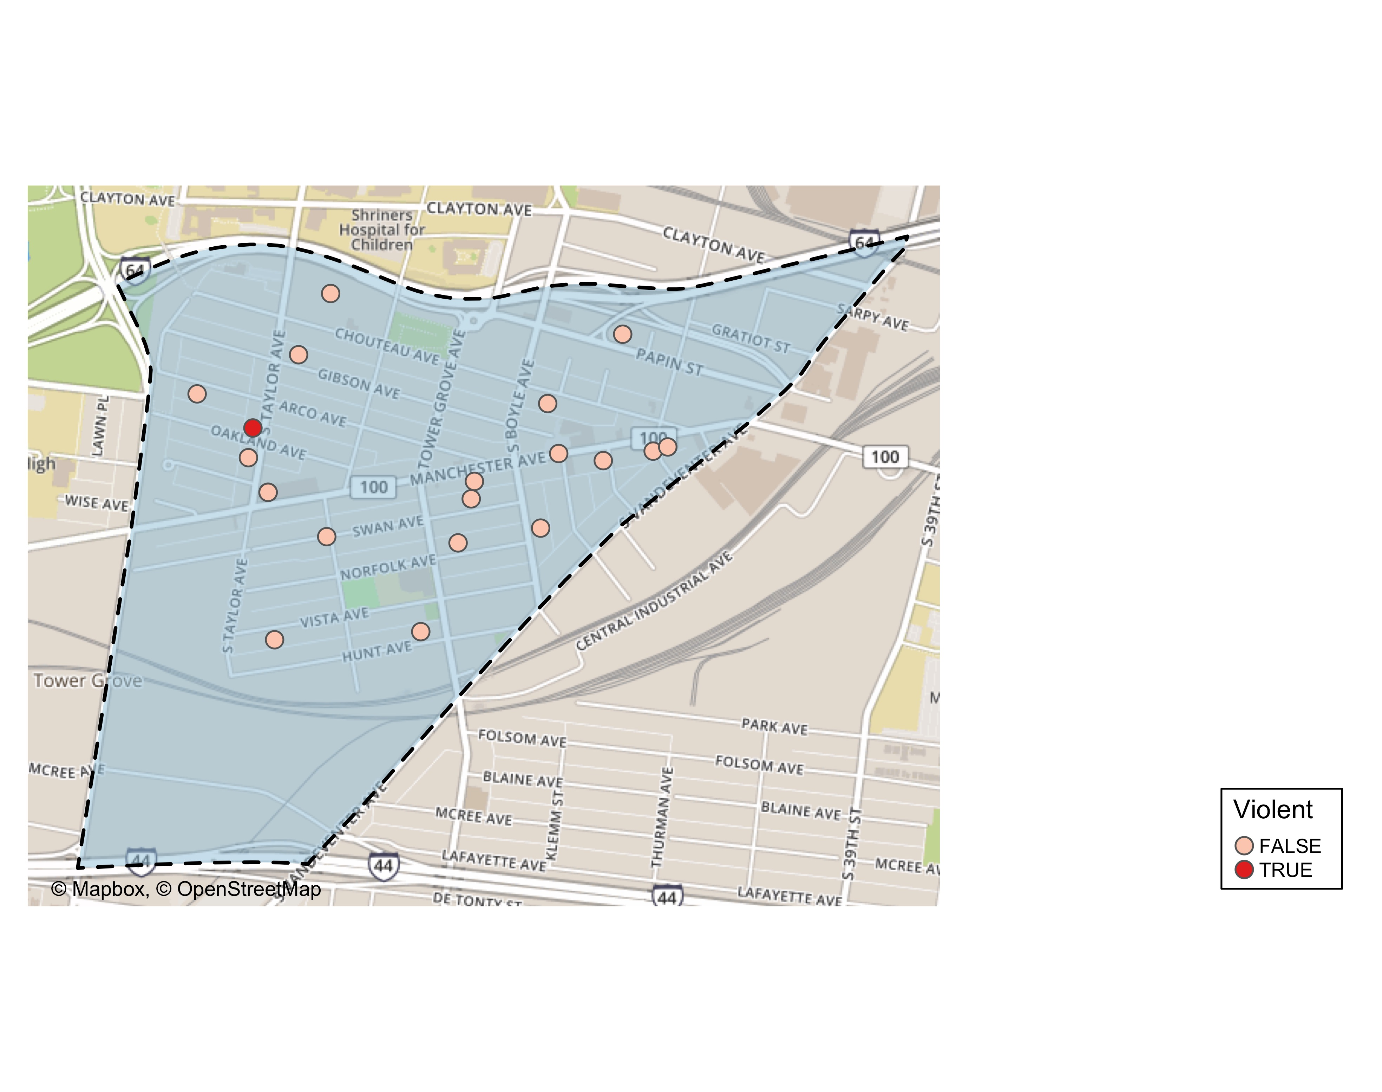
FPSE Violent Crime

Slide 43
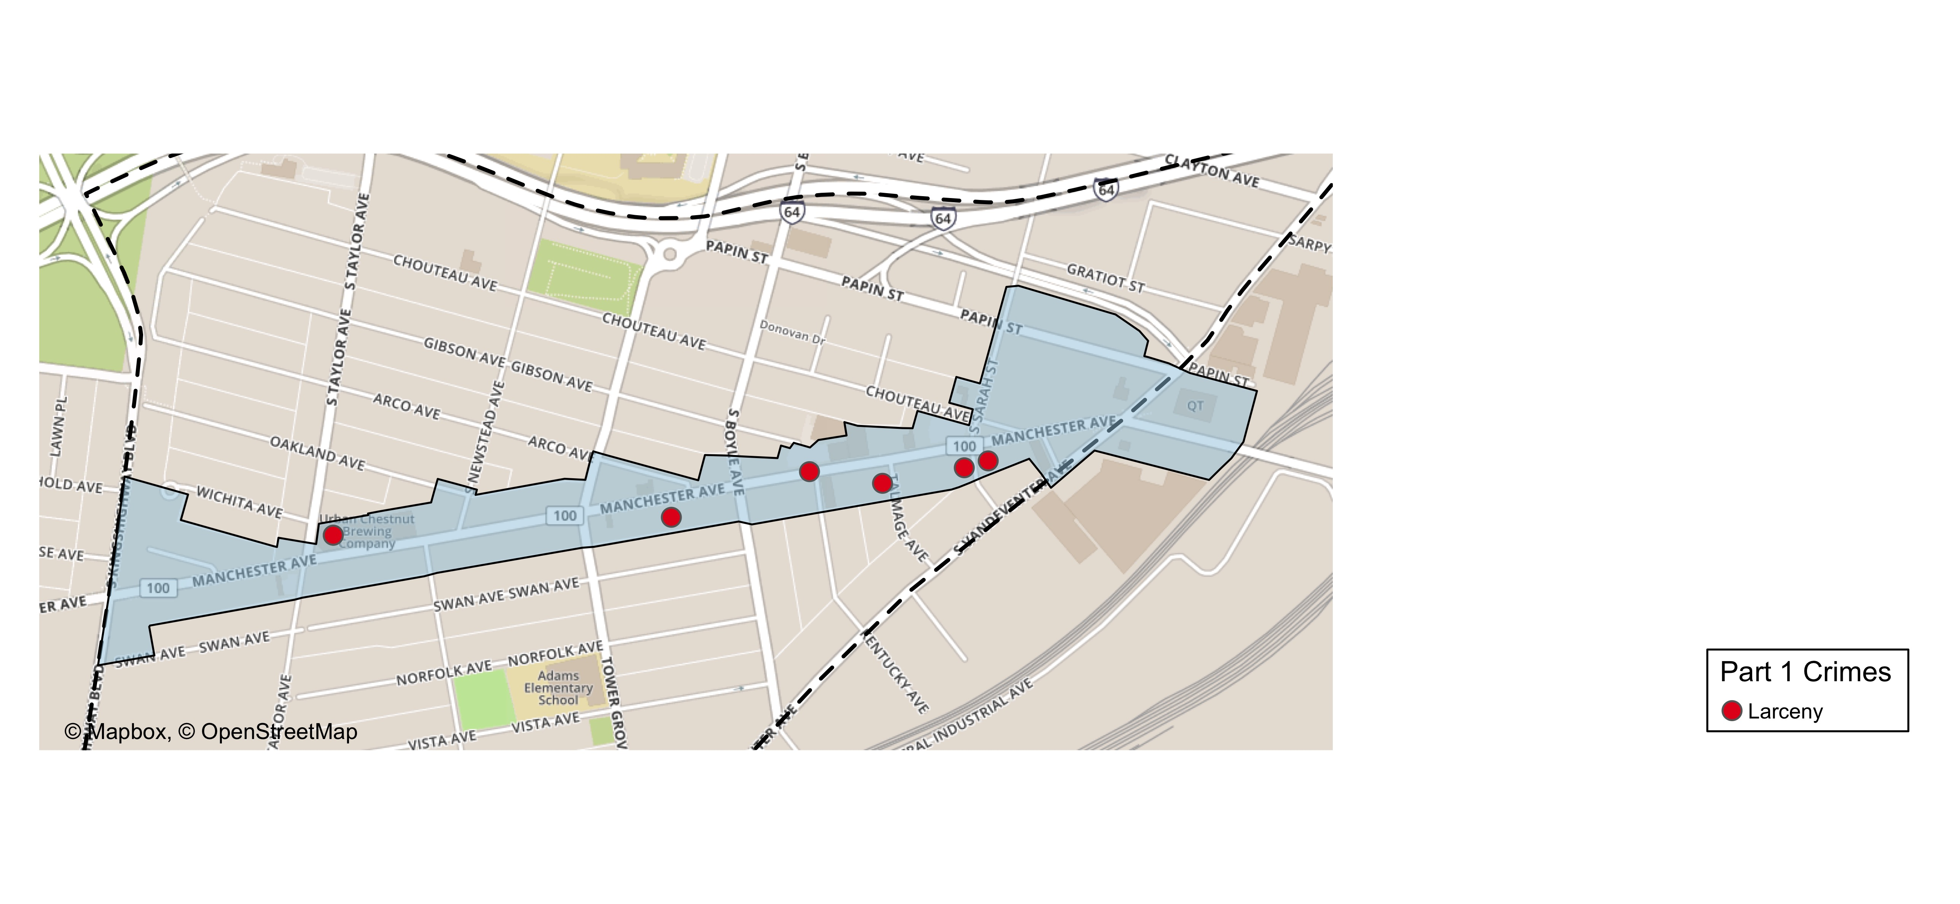
Grove Community Improvement District

Slide 44
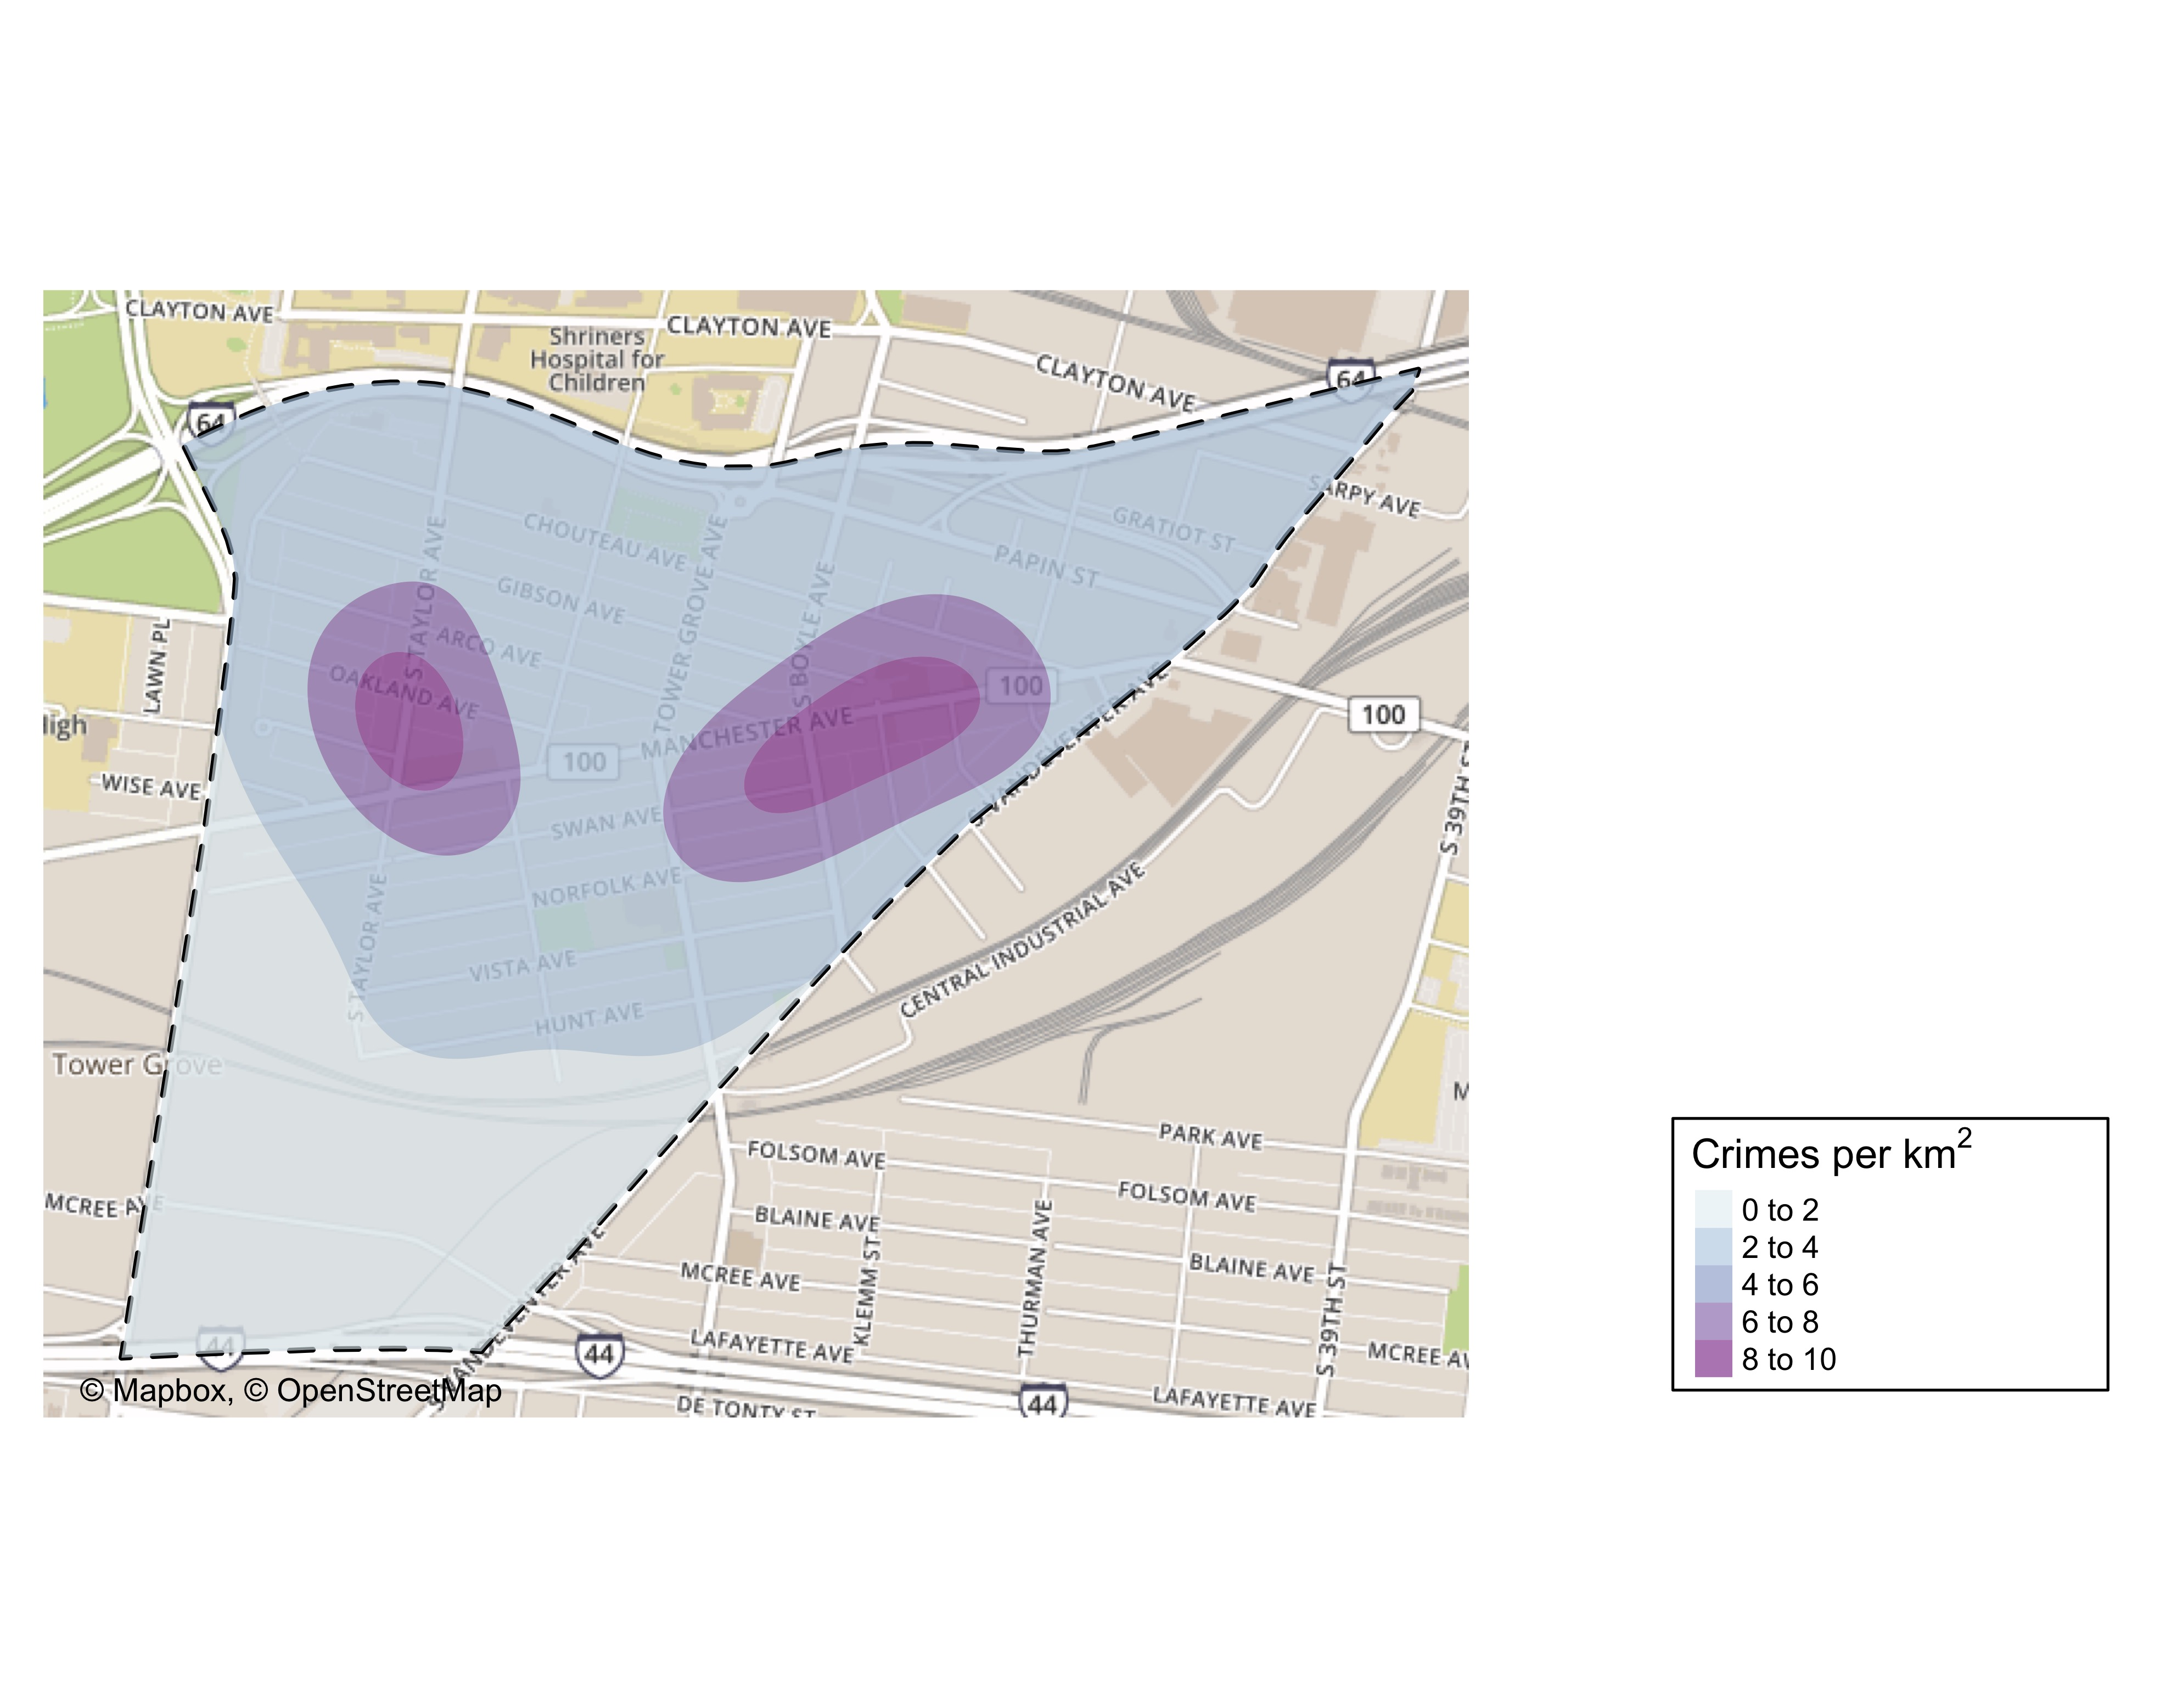
FPSE Crime Density

Slide 45
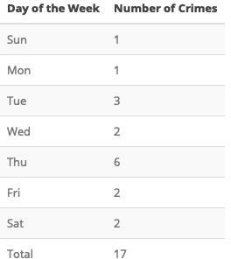
FPSE Larceny Breakdown

Slide 46


Slide 47
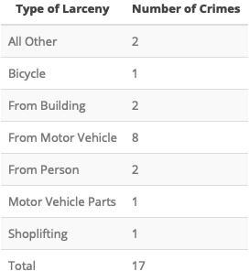

Slide 49
FPSE Total Crimes by Days of the Week
monthCrimes19 %>% filter(., neighborhood == 39) %>% group_by(weekday) %>% count() %>% ggplot(., aes(x=weekday, y=n, group=1)) + geom_line(color="blue") + geom_point() + xlab("Day of Week") + ylab("Total Crimes")

Slide 50
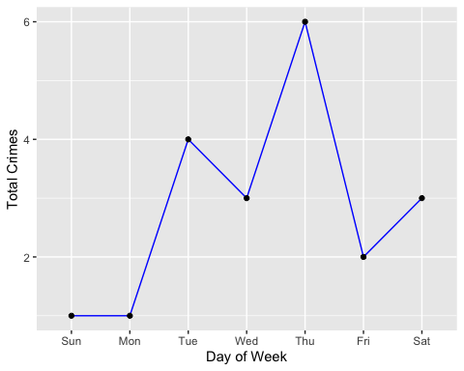

Slide 51
ggsave(here("results/graphs/fpse_crime_weekday.jpeg"), dpi = 500)
## Saving 5 x 4 in image

Slide 52


Slide 53
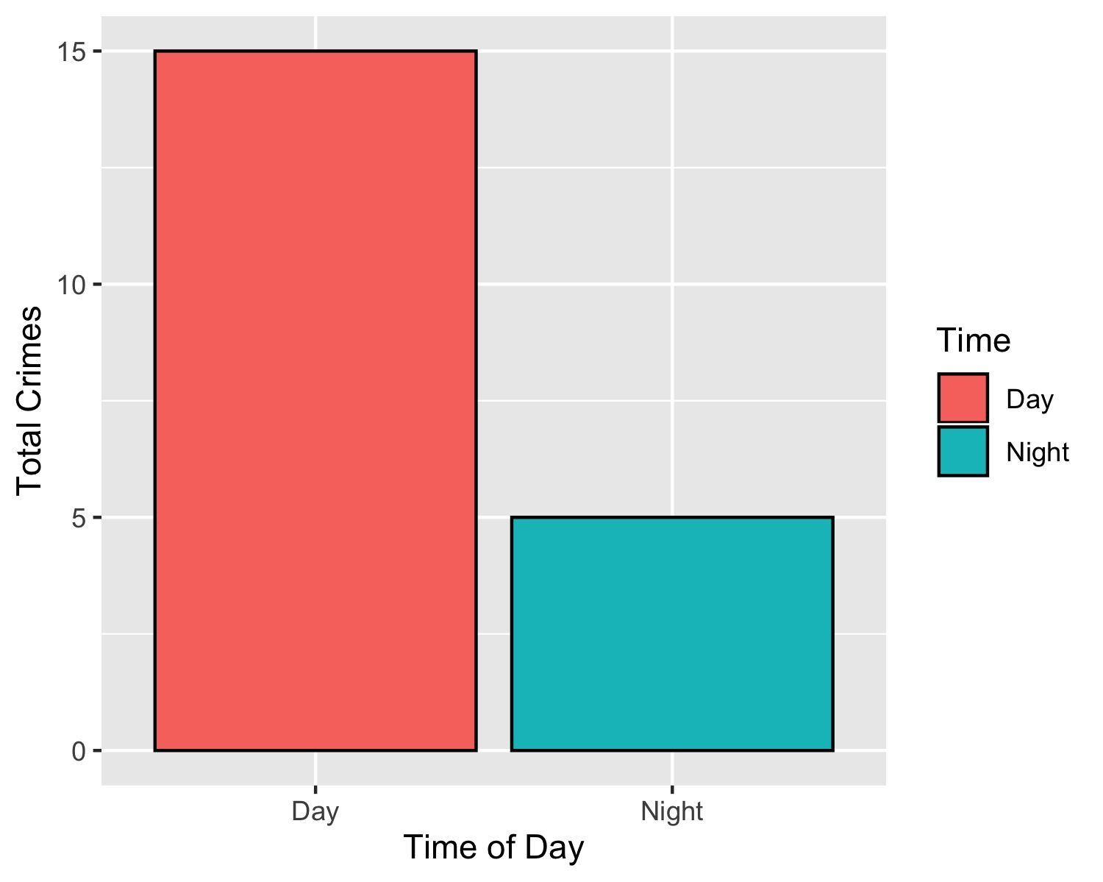
FPSE Crimes by Time of Day

Slide 54
FPSE Crimes by Day & Category
monthCrimes19 %>% filter(., neighborhood == 39) %>% group_by(crimeCatName) %>% ggplot(., aes(weekday)) + geom_bar(aes(fill = crimeCatName), position=position_dodge(), colour="black") + xlab("Day of Week") + ylab("Total Crimes") + labs(fill = "Part 1 Crimes") + scale_fill_brewer(palette = "Spectral")

Slide 55
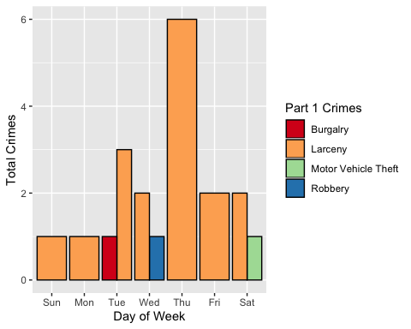

Slide 56
ggsave(here("results/graphs/fpse_crimeCat_weekday.jpeg"), dpi = 300)
## Saving 5 x 4 in image

Slide 57


Slide 58
Central West End Neighborhood Detail
Appendix 2

Slide 59
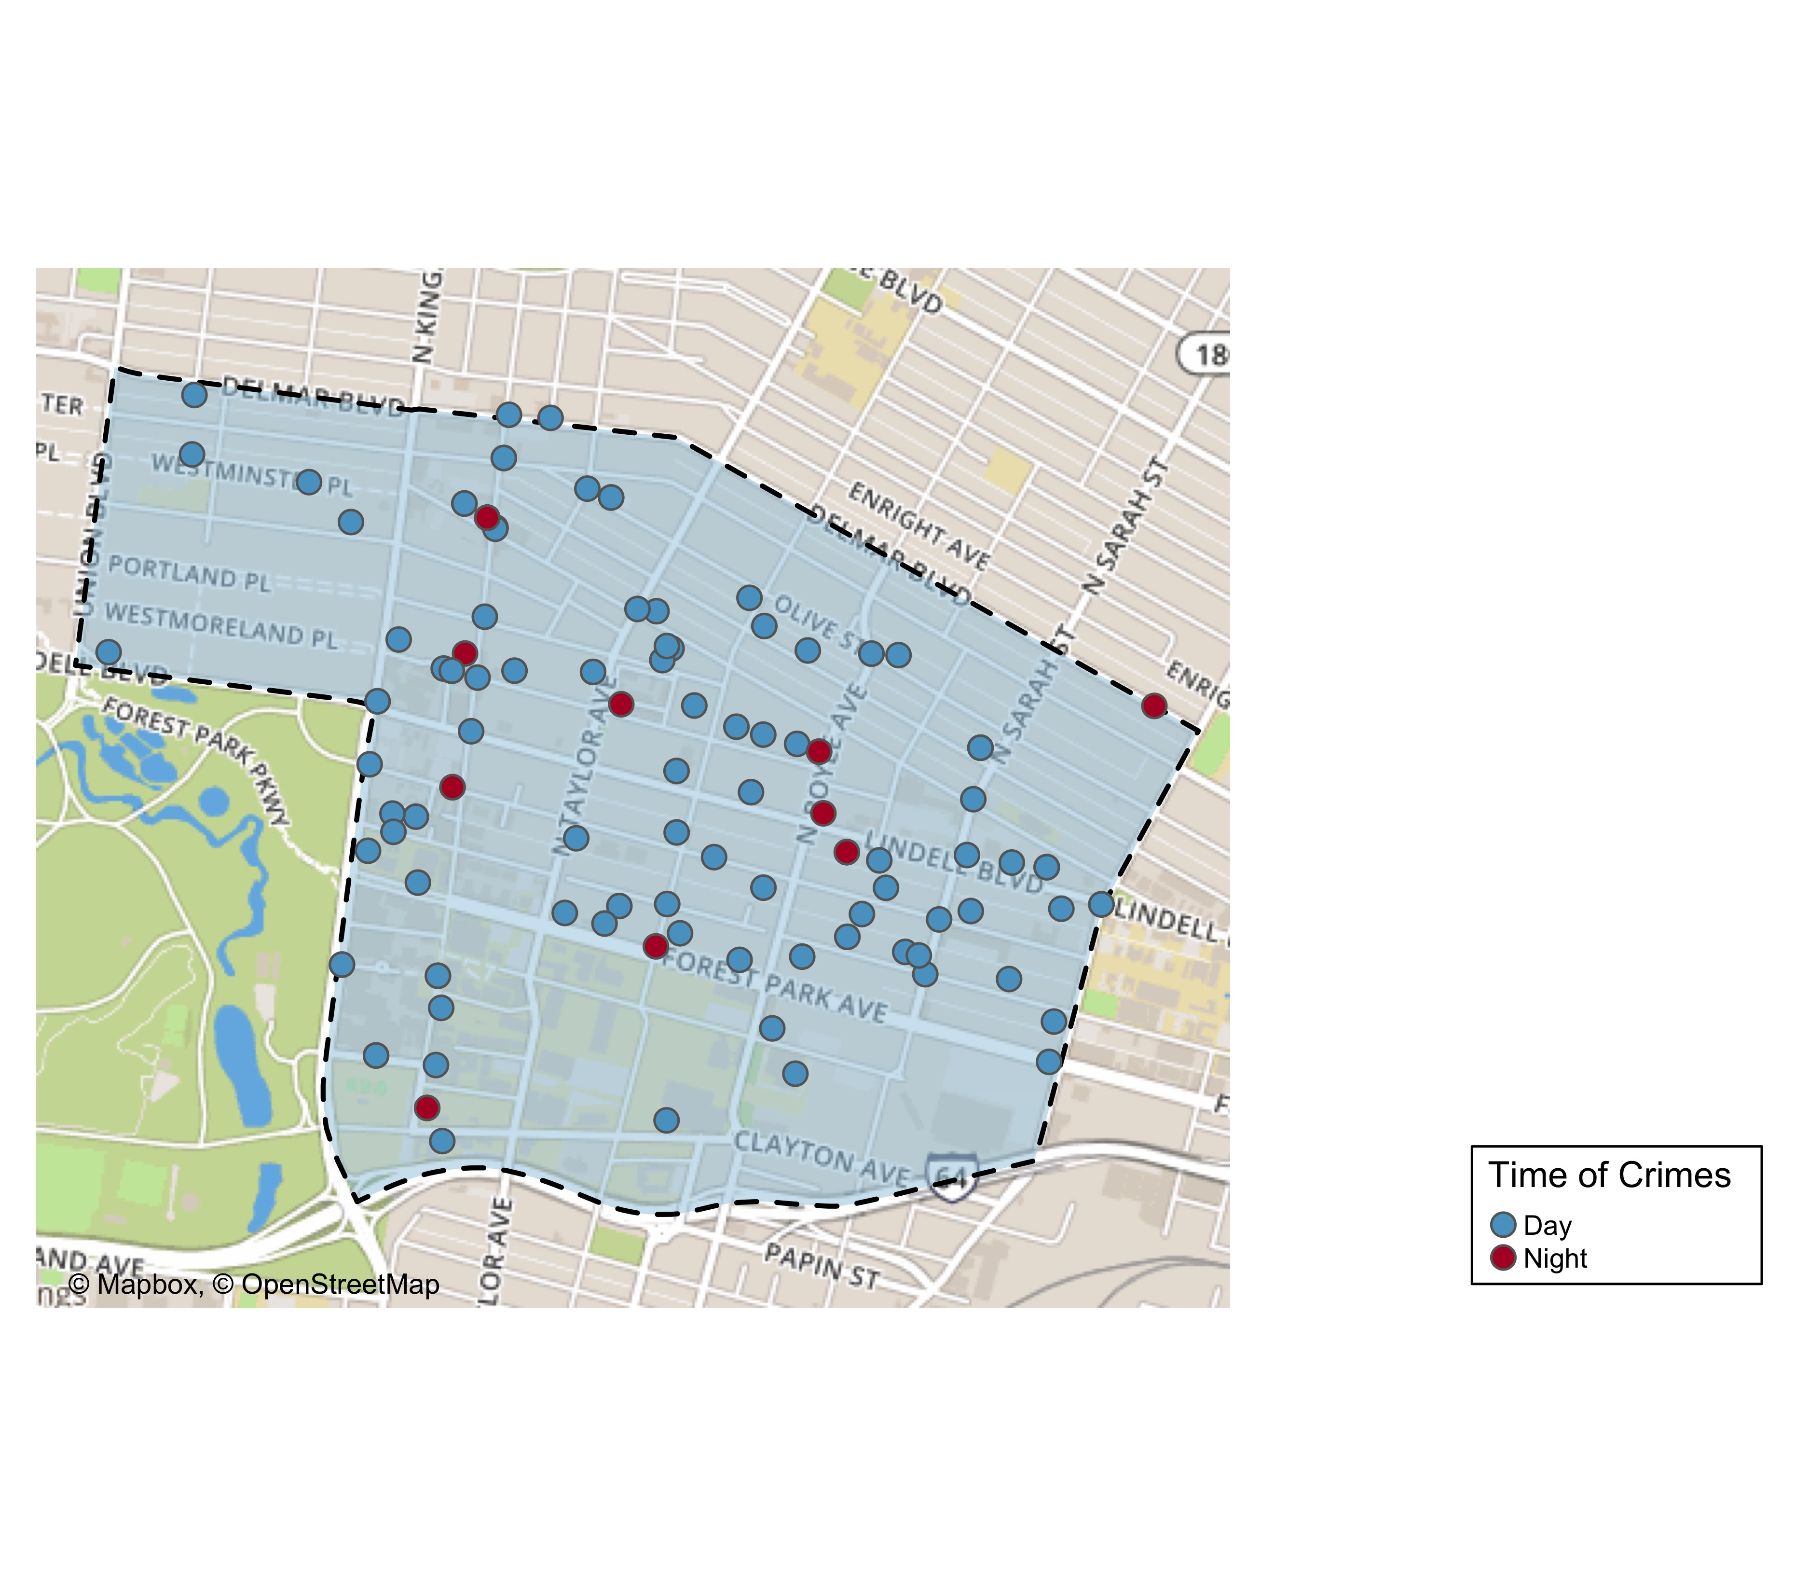
CWE Time of Crimes

Slide 60
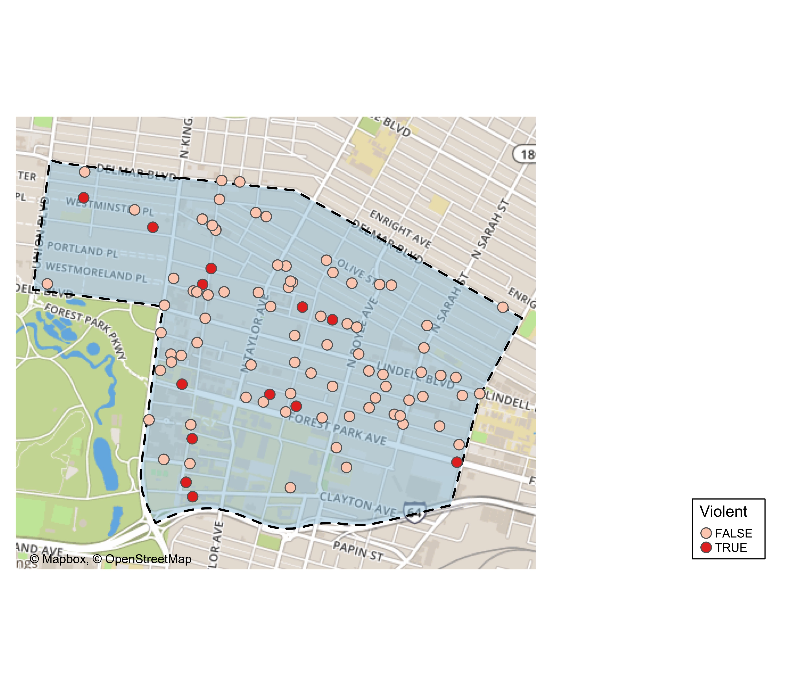
CWE Violent Crime

Slide 61
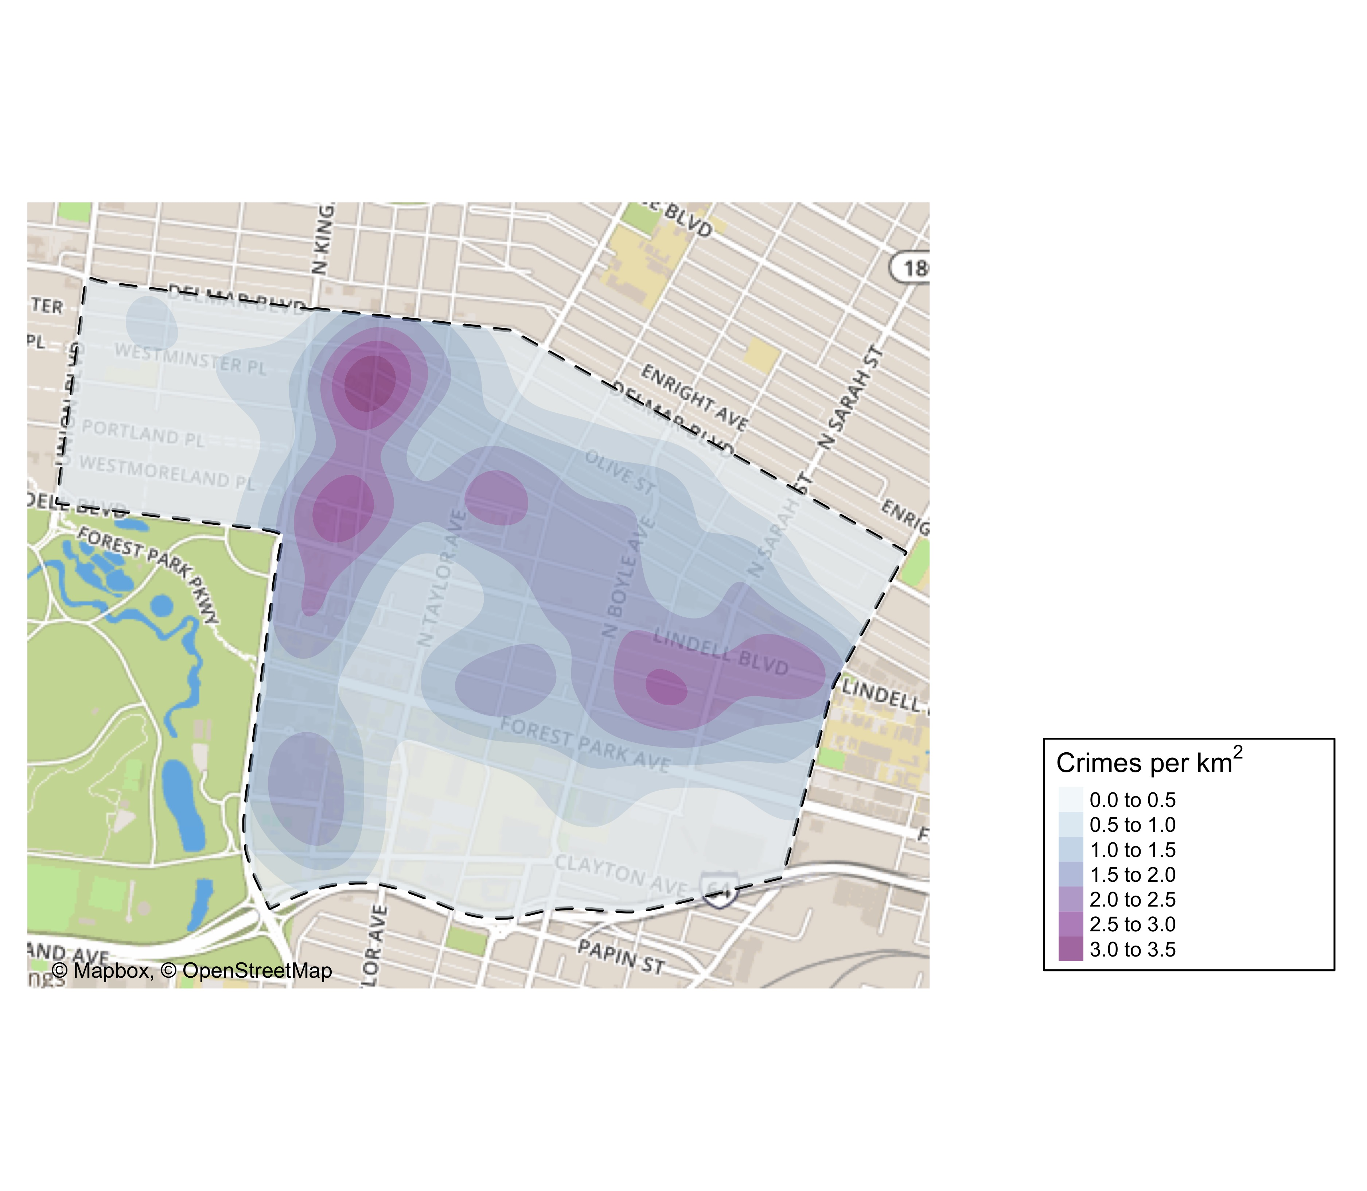
CWE Crime Density

Slide 62
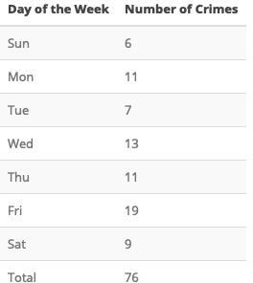
CWE Larceny Breakdown

Slide 63
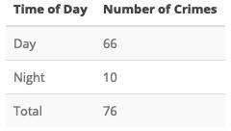

Slide 64
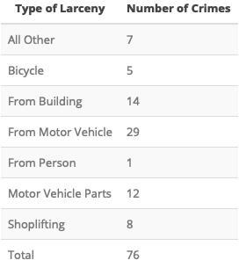

Slide 66
CWE Total Crimes by Days of the Week
monthCrimes19 %>% filter(., neighborhood == 38) %>% group_by(weekday) %>% count() %>% ggplot(., aes(x=weekday, y=n, group=1)) + geom_line(color="blue") + geom_point() + xlab("Day of Week") + ylab("Total Crimes")

Slide 67
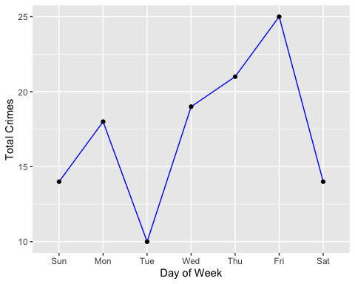

Slide 68
ggsave(here("results/graphs/cwe_crime_weekday.jpeg"), dpi = 500)
## Saving 5 x 4 in image

Slide 69
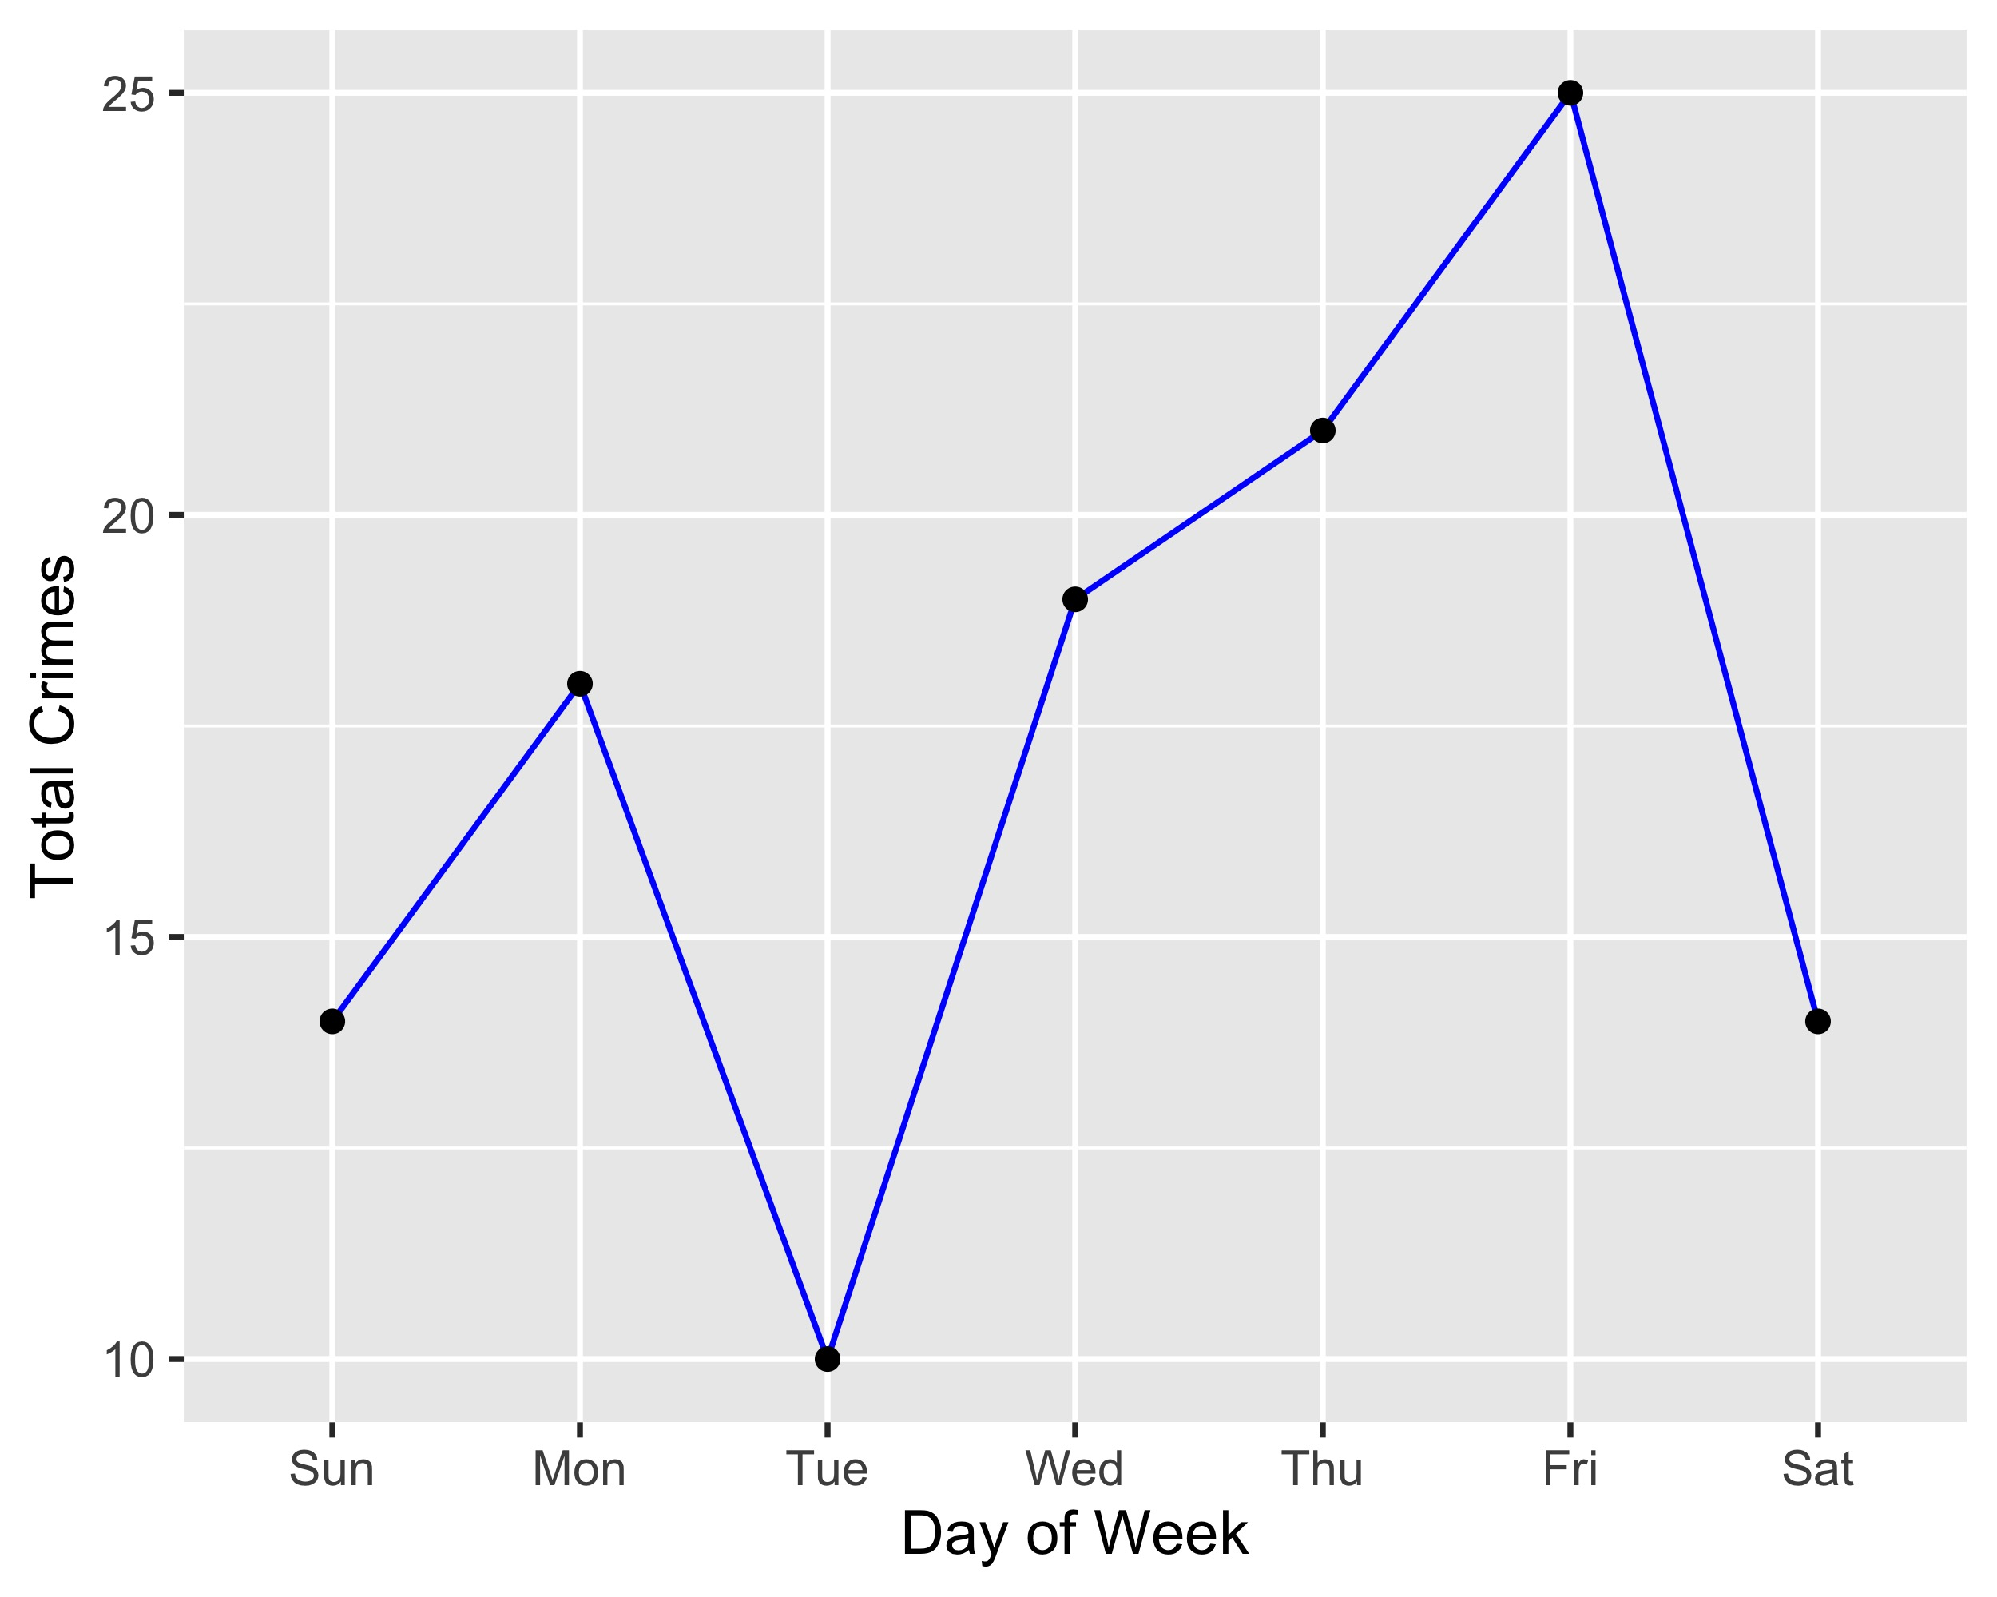

Slide 70
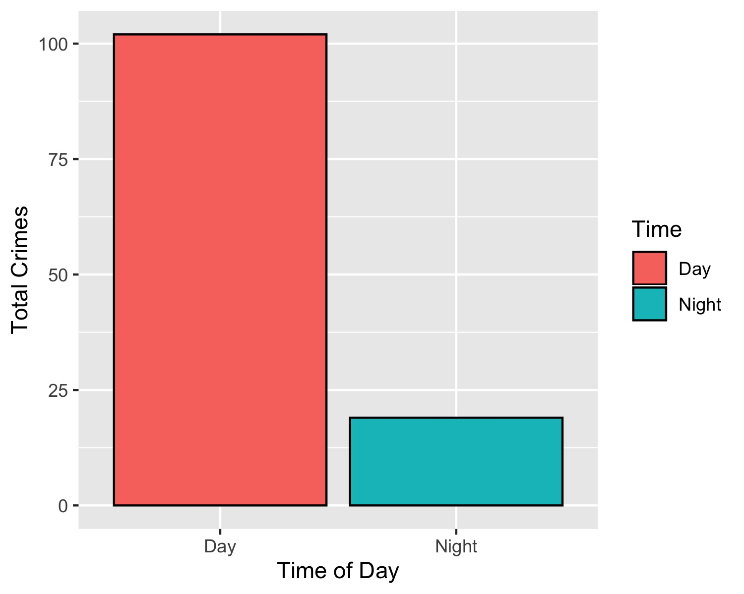
CWE Crimes by Time of Day

Slide 71
CWE Crimes by Day & Category
monthCrimes19 %>% filter(., neighborhood == 38) %>% group_by(crimeCatName) %>% ggplot(., aes(weekday)) + geom_bar(aes(fill = crimeCatName), position=position_dodge(), colour="black") + xlab("Day of Week") + ylab("Total Crimes") + labs(fill = "Part 1 Crimes") + scale_fill_brewer(palette = "Spectral")

Slide 72
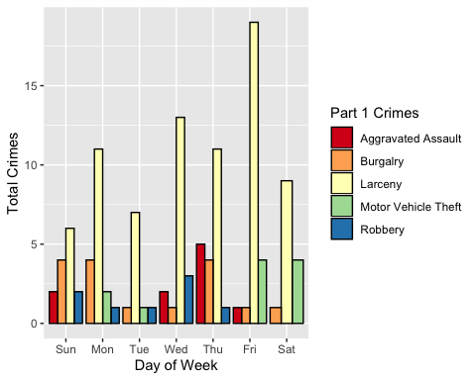

Slide 73
ggsave(here("results/graphs/cwe_crimeCat_weekday.jpeg"), dpi = 300)
## Saving 5 x 4 in image

Slide 74


